Slide 1
Logical View
Dr. Huma Hayat Khan

Slide 2
Class Diagram
The class diagram is a static diagram. It represents the static view of an application.
Class diagram is not only used for visualizing, describing and documenting different aspects of a system but also for constructing executable code of the software application.
The class diagram describes the attributes and operations of a class and also the constraints imposed on the system.
The class diagrams are widely used in the modeling of object oriented systems because they are the only UML diagrams which can be mapped directly with object oriented languages.

Slide 3
The class diagram shows a collection of classes, associations, attributes, and methods. It is also known as a structural diagram.

Slide 4
The following points should be remembered while drawing a class diagram:
The name of the class diagram should be meaningful to describe the aspect of the system.
Each element and their relationships should be identified in advance.
Responsibility (attributes and methods) of each class should be clearly identified.
For each class minimum number of properties should be specified. Because unnecessary properties will make the diagram complicated.
Use notes when ever required to describe some aspect of the diagram. Because at the end of the drawing it should be understandable to the developer/coder.
Finally, before making the final version, the diagram should be drawn on plain paper and rework as many times as possible to make it correct.

Slide 5
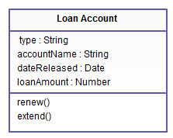
In the example, a class called “loan account” is depicted. Classes in class diagrams are represented by boxes that are partitioned into three:
The top partition contains the name of the class.
The middle part contains the class’s attributes.
The bottom partition shows the possible operations that are associated with the class.

Slide 6
Classes
An entity/class can be a person, place, event, or object that is relevant to a given system.
For example, a school system may include students, teachers, major courses, subjects, fees, and other items.

Slide 7
Cont…
Those should be pretty easy to see in the example: the class being described is a loan account, some of whose attributes include the type of loan, the name of the borrower/loaner, the specific date the loan was released and the loan amount.
As in the real world, various transactions or operations may be implemented on existing loans such as renew and extend. The example shows how class diagrams can encapsulate all the relevant data in a particular scenario in a very systematic and clear way.

Slide 8
Cont…
In object-oriented modeling, class diagrams are considered the key building blocks that enable information architects, designers, and developers to show a given system’s classes, their attributes, the functions or operations that are associated with them, and the relationships among the different classes that make up a system.

Slide 9
Relationships in Class Diagrams
Classes are interrelated to each other in specific ways. In particular, relationships in class diagrams include different types of logical connections. The following are such types of logical connections that are possible in UML:
Association
Directed Association
Multiplicity
Aggregation
Inheritance/Generalization

Slide 10
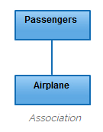
Association
Association is a broad term that encompasses just about any logical connection or relationship between classes. For example, passenger and airline may be linked as above:

Slide 11
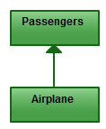
Directed Association
Directed Association refers to a directional relationship represented by a line with an arrowhead. The arrowhead depicts a container-contained directional flow.

Slide 12
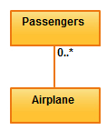
Multiplicity
is the active logical association when the cardinality of a class in relation to another is being depicted.
For example, one commercial airplane may contain zero to many passengers. The notation 0..* in the diagram means “zero to many”.

Slide 13
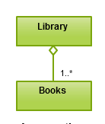
Aggregation
refers to the formation of a particular class as a result of one class being aggregated or built as a collection.
For example, the class “library” is made up of one or more books, among other materials.
In aggregation, the contained classes are not strongly dependent on the life cycle of the container.
In the same example, books will remain so even when the library is dissolved. To render aggregation in a diagram, draw a line from the parent class to the child class with a diamond shape near the parent class.

Slide 14
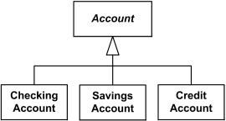
Inheritance/Generalization
refers to a type of relationship wherein one associated class is a child of another by virtue of assuming the same functionalities of the parent class.
In other words, the child class is a specific type of the parent class.
To depict inheritance in a UML diagram, a solid line from the child class to the parent class is drawn using an unfilled arrowhead.

Slide 15
How to identify the concepts

Slide 16
Concepts through category list
Concept category | system concepts
Physical or tangible objects
Specifications, design, or description of things
Places
Transactions
Transaction line item
Roles of people
Containers of other things
Things in a container
Other computer or electro mechanical systems external to our system
organizations

Slide 17
Concept category | example
events
Rules and policies
Catalogs
Records of finance, work, contracts, legal matters
Financial instruments and services
Manuals, books

Slide 18
Point of Sale Terminal (POST)
Concept category | system concepts
Physical or tangible objects | POST
Specifications, design, or description of things | Product Specification
Places | Store
Transactions | Sale, payment
Transaction line item | Sales Line Item
Roles of people | Cashier, Manager, Customer
Containers of other things | Store, Bin
Things in a container | Item
Other computer or electro mechanical systems external to our system | Credit card authorization system
organizations | Sales department

Slide 19
Concept category | example
events | Sale, robbery, meeting
Rules and policies | Refund policy
Catalogs | Product catalog
Records of finance, work, contracts, legal matters | Receipt, ledger, employment contract
Financial instruments and services | Line of Credit
Manuals, books | Employee manual

Slide 20
Initial concept model
POST
Items
STORE
Sales
Sales Line Item
Cashier
Customer
Manager
Payment
Product Catalog
Product Specification

Slide 21
Associations
An association is represented as a line between the concepts with an association name.
The ends of an association may contain a multiplicity expression indicating the numerical relationship between instances of the concept.

Slide 22
Finding Associations- Association list
Category | system concepts
A is a physical part of B
A is a logical part of B
A is physically contained in/on B
A is logically contained in B
A is a description for B
A is a line item of a transaction or report B
A is logged/ recorded/ reported/ captured in B
A is a member of B
A is an organizational subunit of B
A uses or manages B

Slide 23
Concept category | example
A communicates with B
A is related to a transaction B
A is a transaction related to another transaction B
A is next to B
A is owned by B

Slide 24
POST example
Category | system example
A is a physical part of B | Not applicable
A is a logical part of B | Sales line item - sales
A is physically contained in/on B | POST - Store
A is logically contained in B | Product specification – product catalog
A is a description for B | Product specification - item
A is a line item of a transaction or report B | Sales line item - sale
A is logged/ recorded/ reported/ captured in B | (completed) Sales – Store (current) Sale - POST
A is a member of B | Cashier - Store
A is an organizational subunit of B | Not applicable
A uses or manages B | Cashier – POST Manager – POST

Slide 25
Concept category | example
A communicates with B | Customer – Cashier
A is related to a transaction B | Customer – Payment Cashier – Payment
A is a transaction related to another transaction B | Payment – Sales
A is next to B | POST – POST (but probably not applicable)
A is owned by B | POST – Store

Slide 26
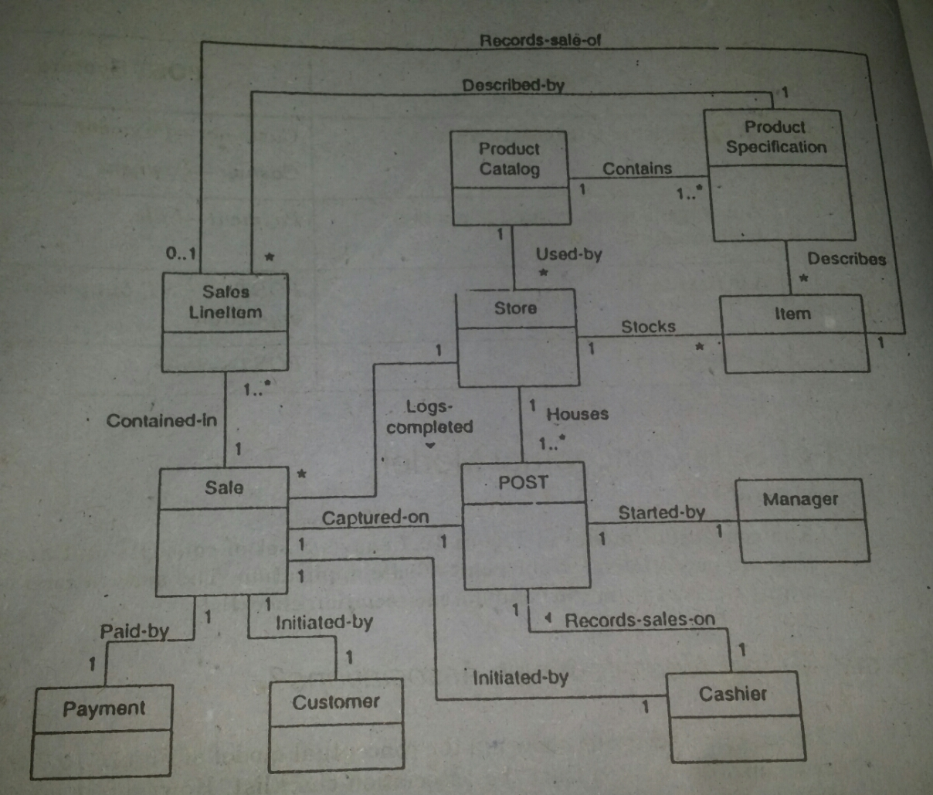

Slide 27
Adding attributes
The attributes in conceptual model should be simple.
Very common simple attributes types are:
Boolean
Date
Number
String
Time

Slide 28
Other common types include
Address
Color
Geometrics (point, rectangle…)
Phone number
Social security number
Universal product code
etc…..

Slide 29
Some examples
1 Uses 1
cashier
POST
Name: String
Number: Number
Payment
Amount: quantity
Product Specification
Description : String
Price: quantity
upc: UPC
Store
address: Address
name: String

